Slide 1

CO-CURRICULUM OF ISOT
OTHER TOOLS FOR SUCCESS

Slide 2
Howard Gardner
Professor of Cognition and Education,
Faculty of Arts and Scientists,
Harvard University
Eight Distinct Intelligences
Verbal
Logical/Mathematical
Bodily/Kinesthetic
Musical
Spatial
Interpersonal
Intrapersonal
Naturalistic

Slide 3
Howard Gardner
Professor of Cognition and Education,
Faculty of Arts and Scientists,
Harvard University
“We can increase intelligence by creating opportunities for students to find and solve problems — especially problems which require us to think creatively, carefully, and strategically.
We can essentially teach children how to think better”.

Slide 4
AREAS OF DEVELOPMENT
Leadership and Teamwork
Social and Community Service
Performing Arts
Sports
Career/Professional Orientation
Research and Presentation

Slide 5
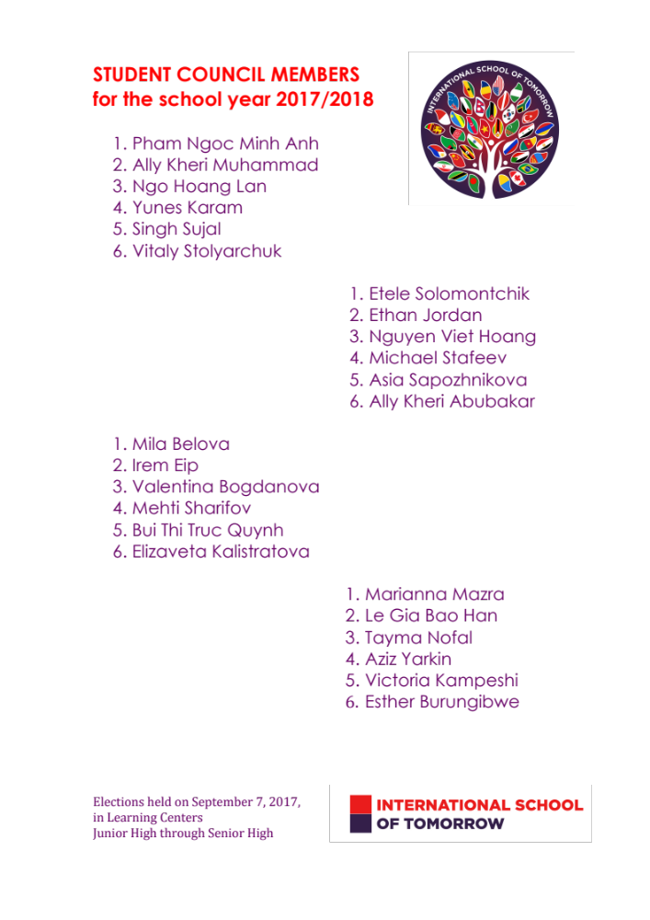
STUDENT COUNCIL
6 COMMITTEES
Executive Committee:
President and Vice-Presidents
Finance Committee
Education Committee
Media and Events Committee
Labor Committee
Sports Committee

Slide 6

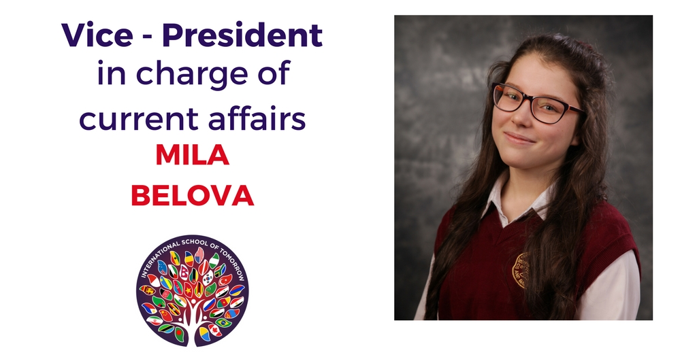

STUDENT COUNCIL
SKILLS IN TRAINING
Generating workable and practical ideas
Organizing the work of a team of peers
Learning to outsource
Living up to commitments
Building a working relationship with your committee/team
Making business plans
Budgeting
Accounting and reporting
Media coverage of work and events
Event promotion

Slide 7
TED-ED CLUB
3 STAGES OF APPROVAL
FROM THE NEW YORK TED OFFICE:
APPLICATION
INTERVIEW
EXAMINATION/QUESTIONNAIRE
APPROVAL

Slide 8
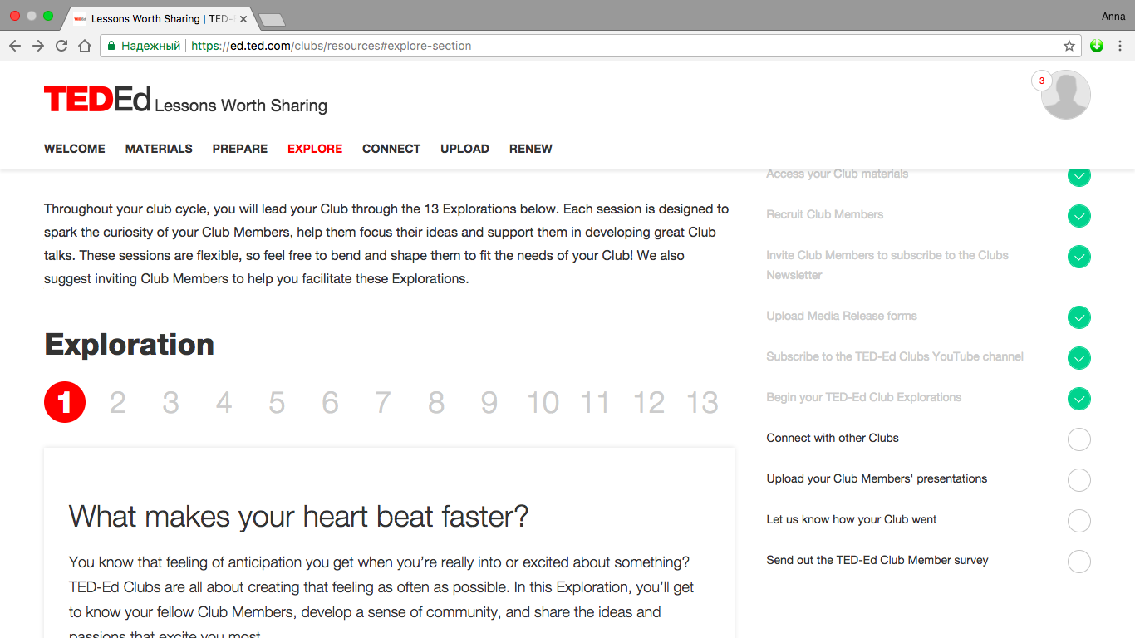
TED-ED CLUB

Slide 9
TED-ED CLUB
WHO:
53 members
Senior I
Senior II
Senior High
2 Club Leaders
ANNA MARA
DAVID JORDAN
HOW:
2 hours of group work
2 hours of individual work
PER WEEK
RESULT:
TED Talks – March/April 2018
TED certificates
Public speaking
Speech writing
Essay writing
SKILLS IN TRAINING
Research
Source evaluation
Defining passions
Visualization of material
Group work
Idea formulating

Slide 10
CLUBS
TED-Ed Club High School
Dance Club Middle and High School Music Club Middle and High School
Intellectuals Club Russian Program
Choreography and Music Everyone

Slide 11
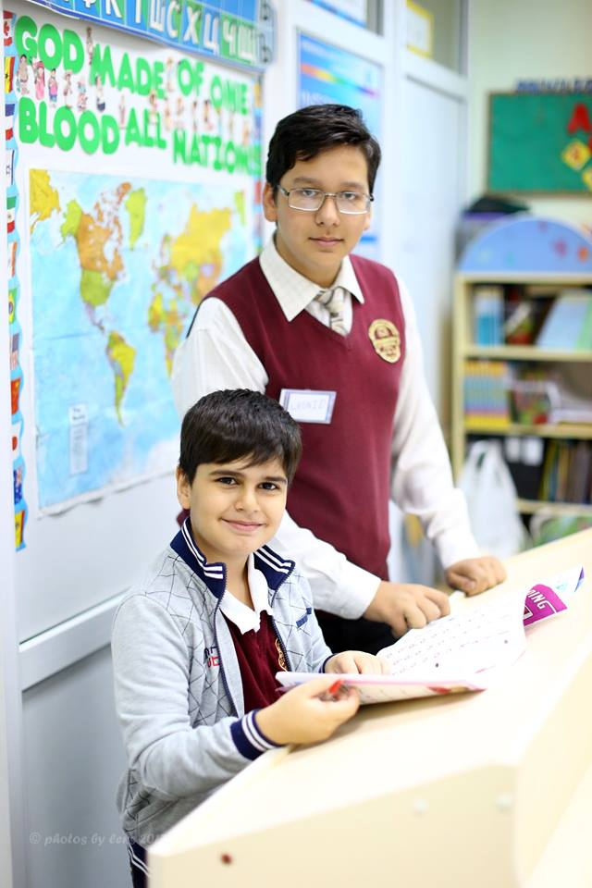
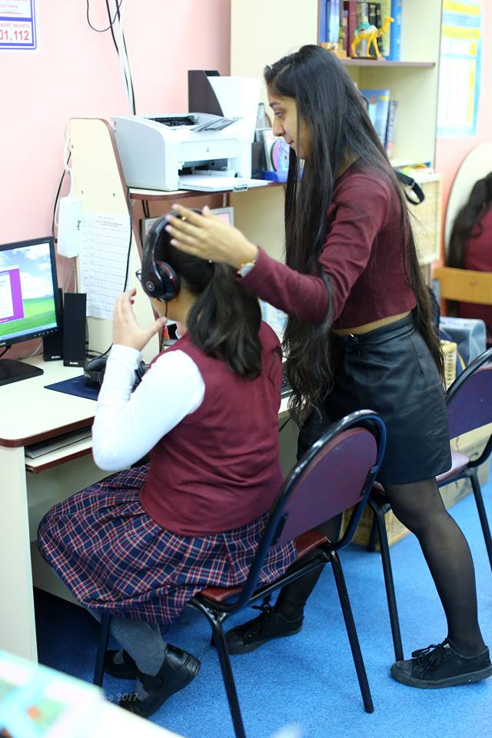
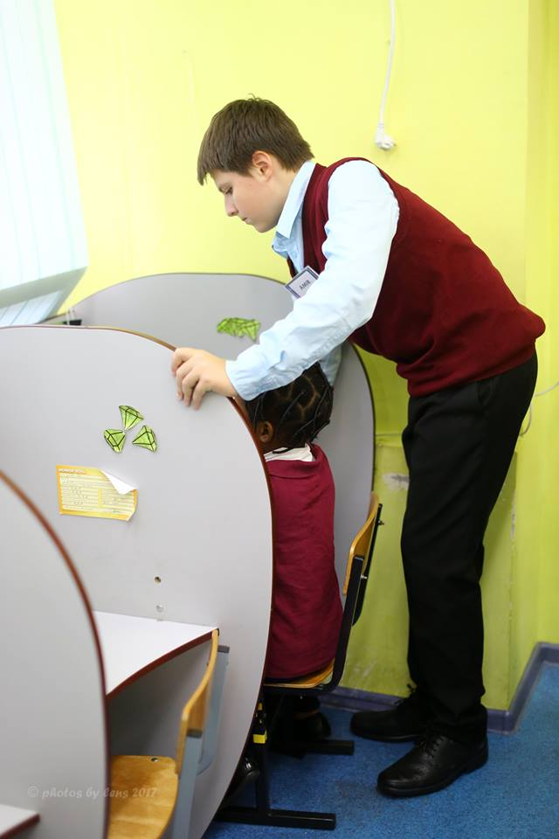
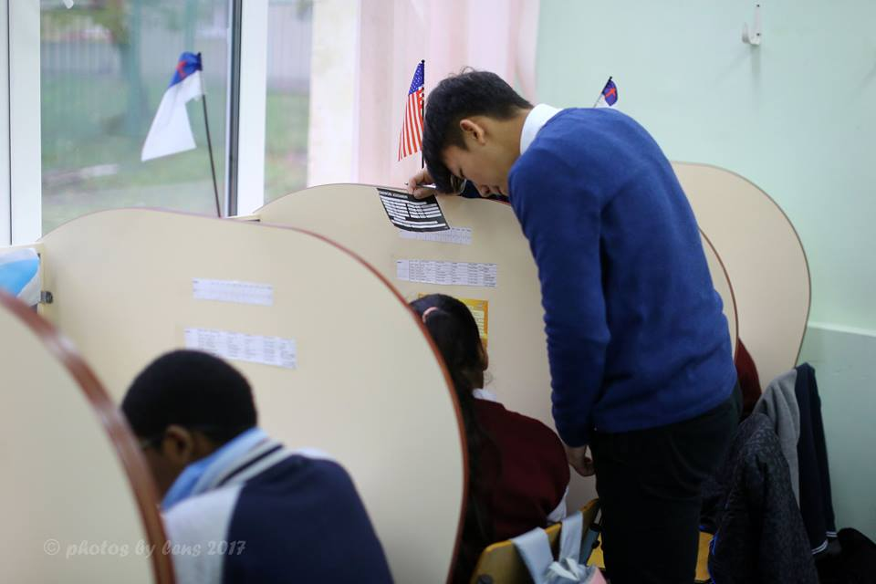
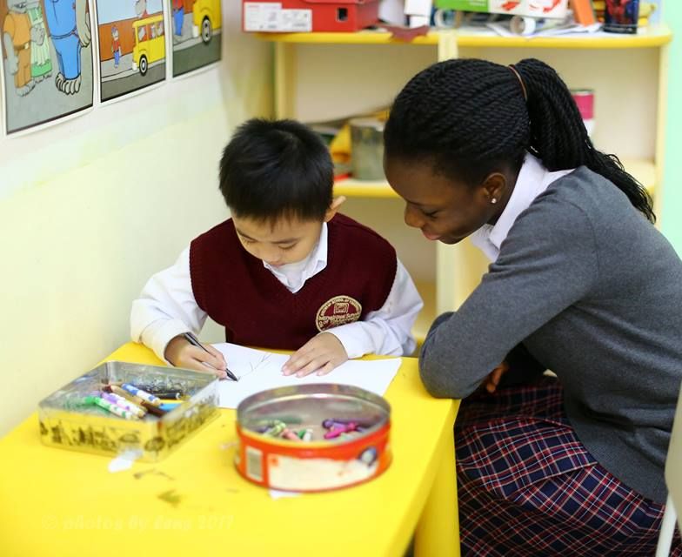
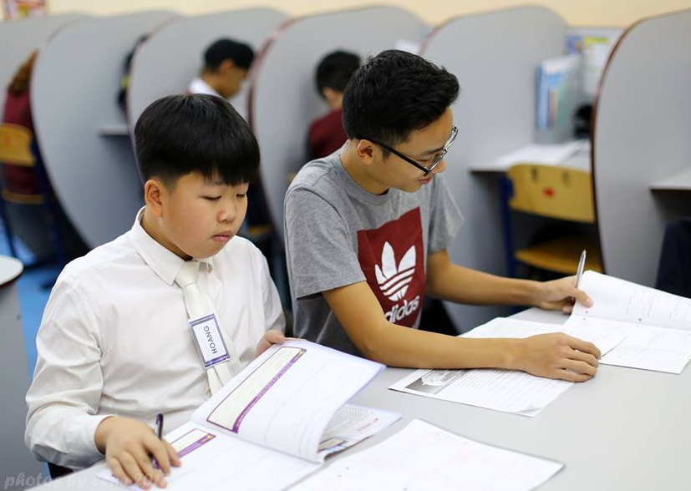
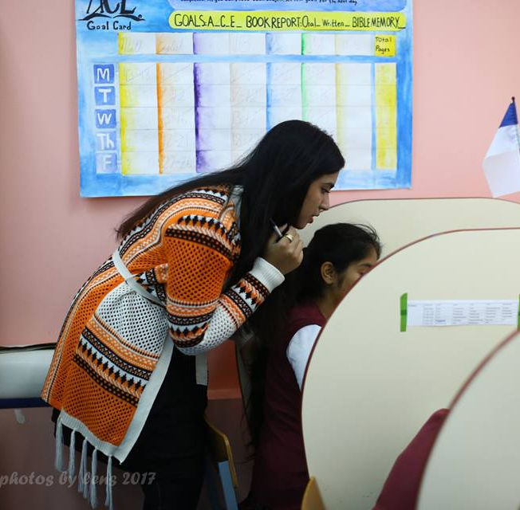
TRAINING IN PROFESSIONS

Slide 12
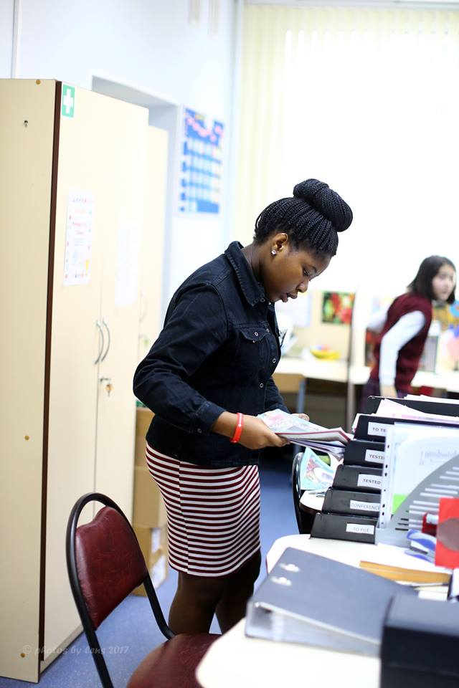
SELF-MANAGEMENT
SKILLS IN TRAINING
Planning and training for a job
Helping set goals for others
Monitoring others’ progress
Dealing with others’ success and failure
Learning to organize the work of a group
Controlling emotions in a work setting
The art of encouragement and motivating others
Understanding the challenges of a teacher’s profession

Slide 13
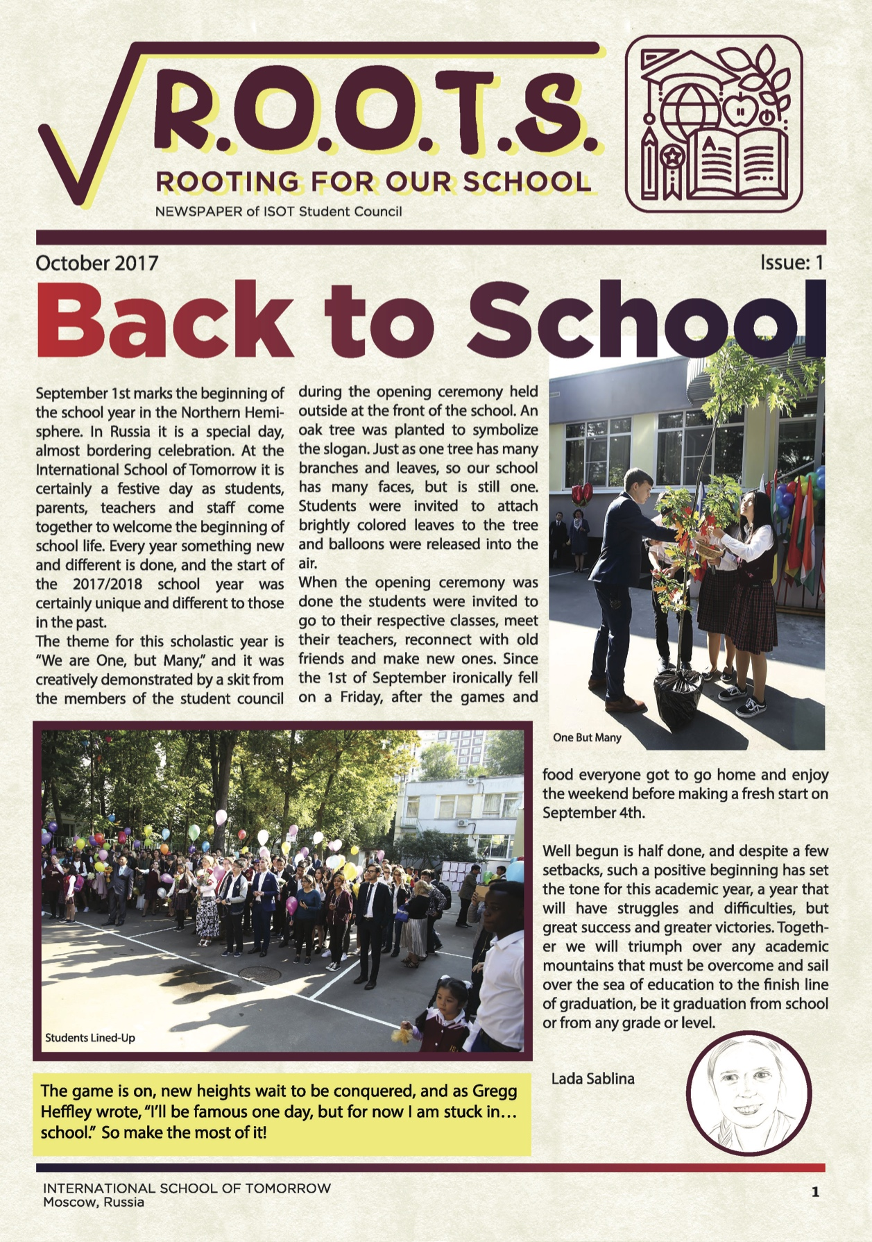
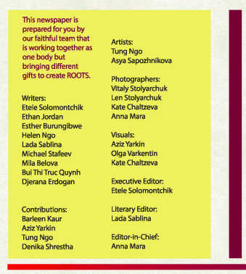
STUDENT COUNCIL NEWSPAPER

Slide 14
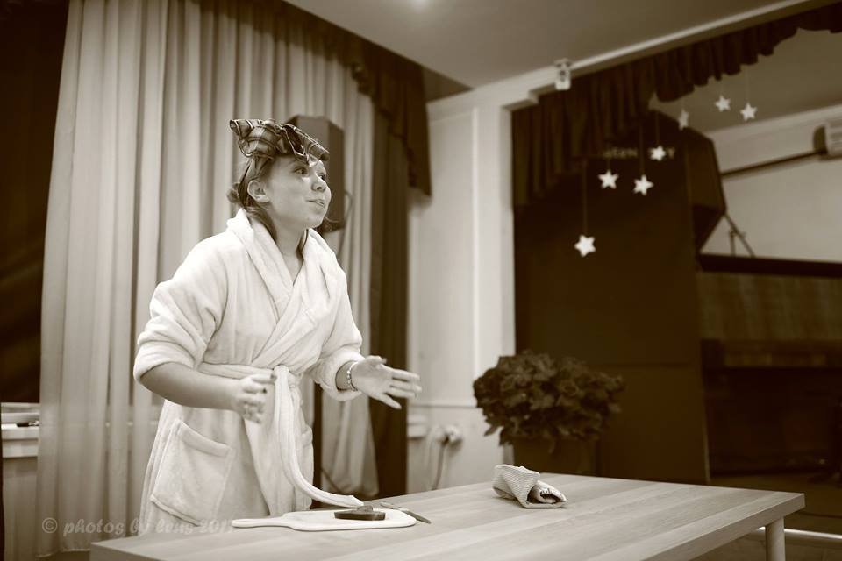
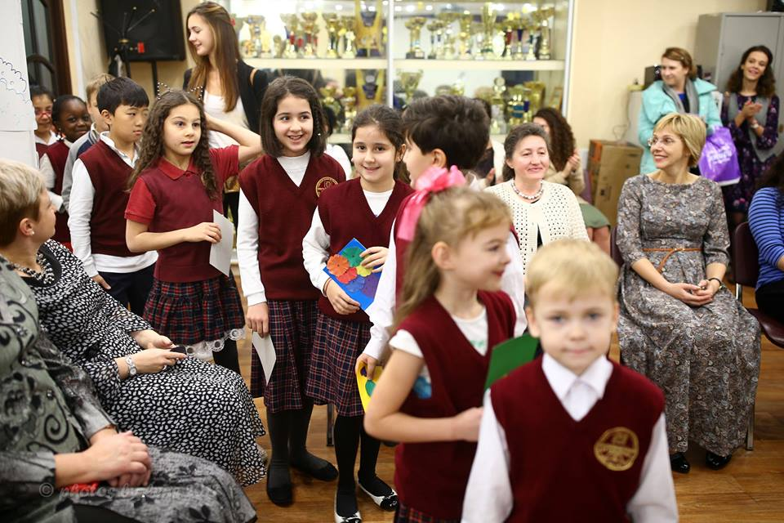
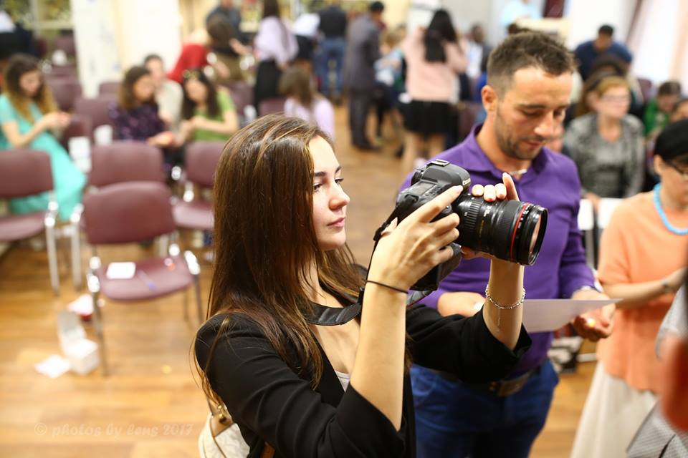
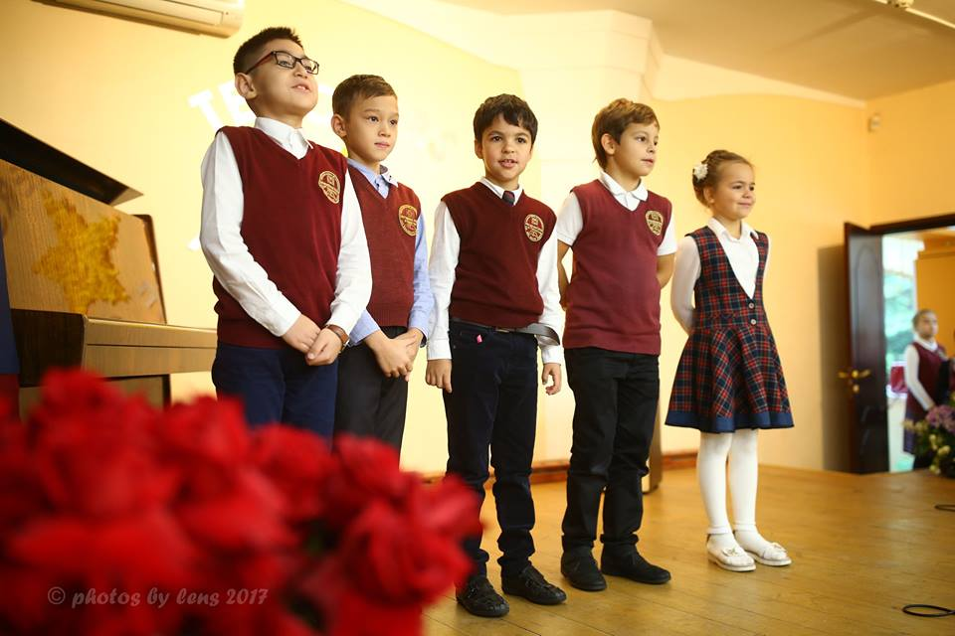
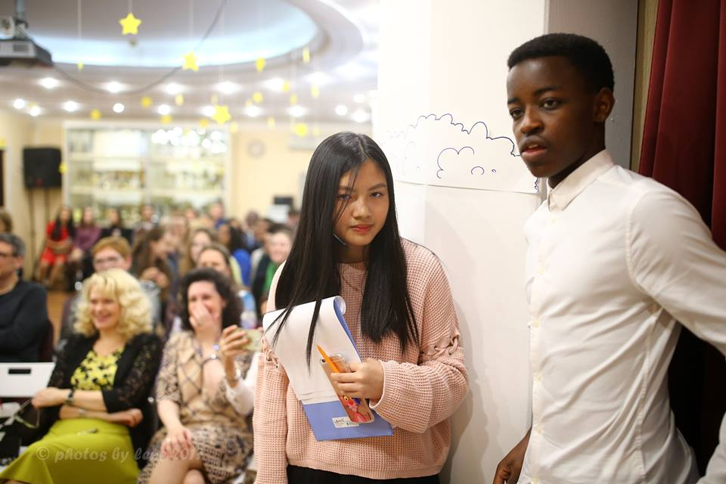
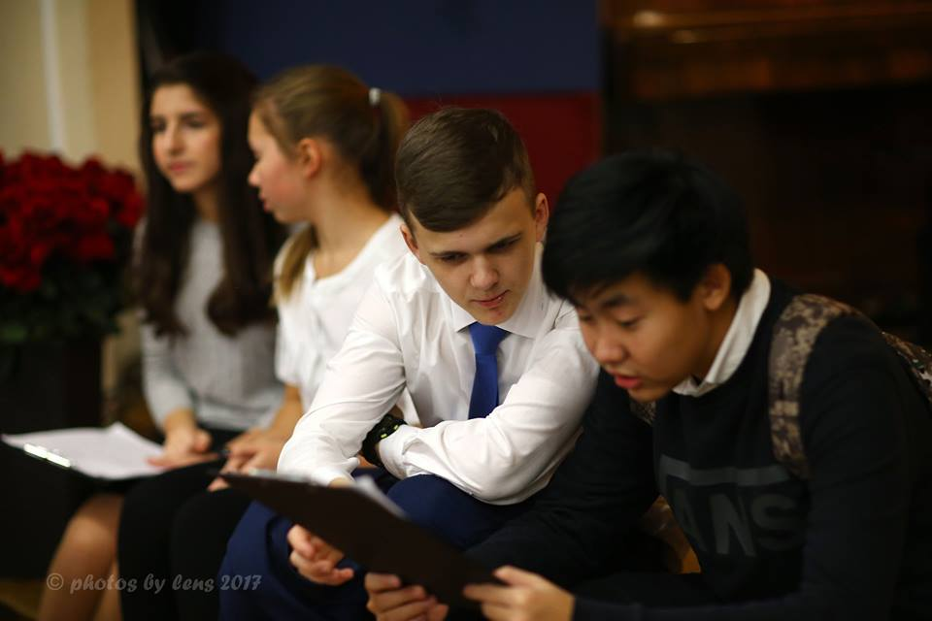
EVENTS

Slide 15
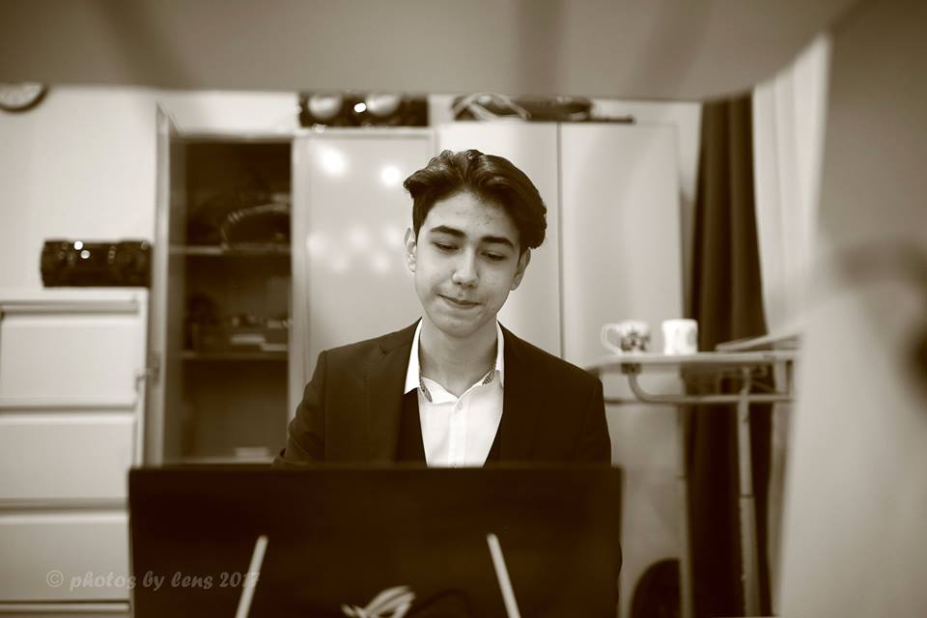
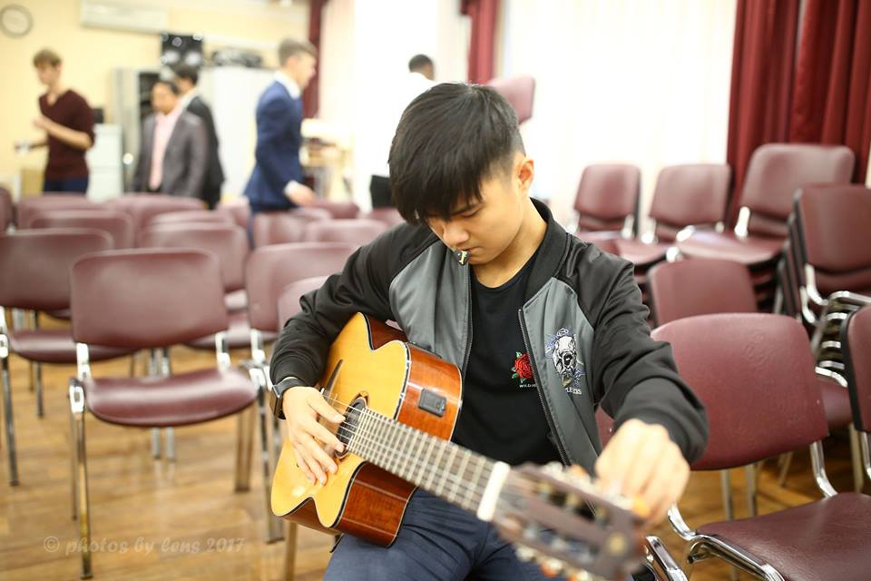
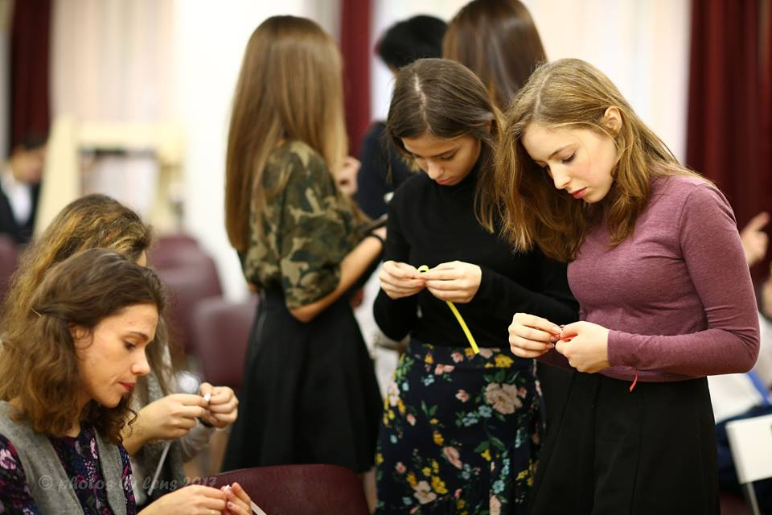
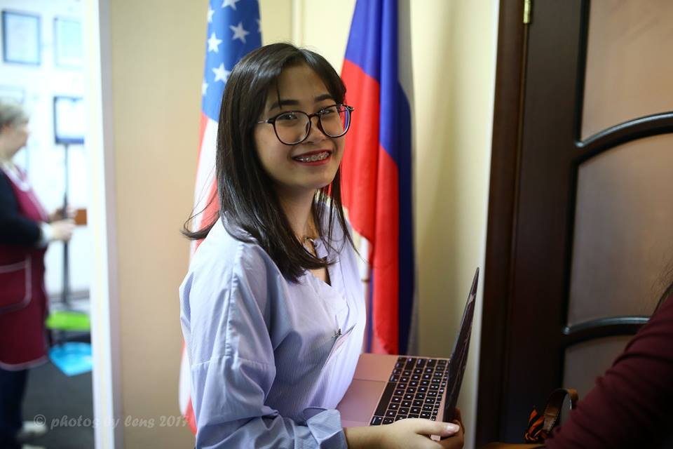
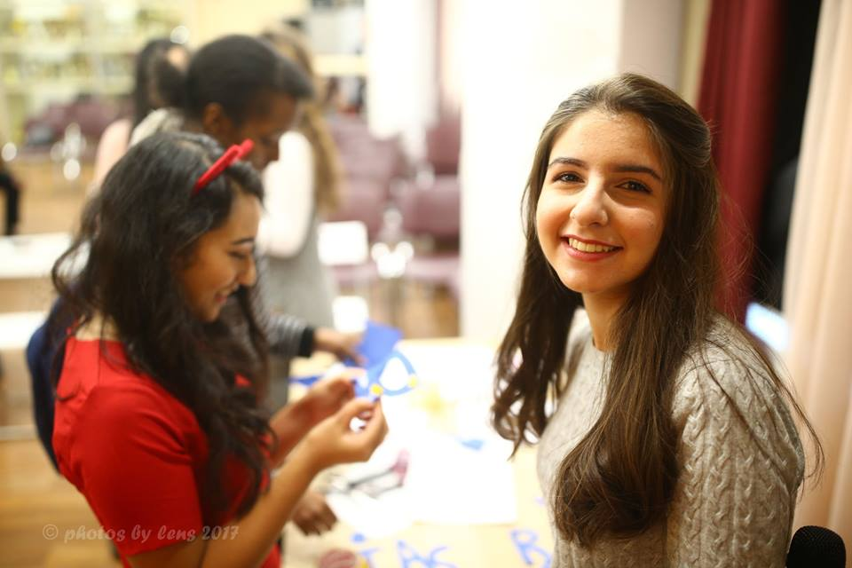
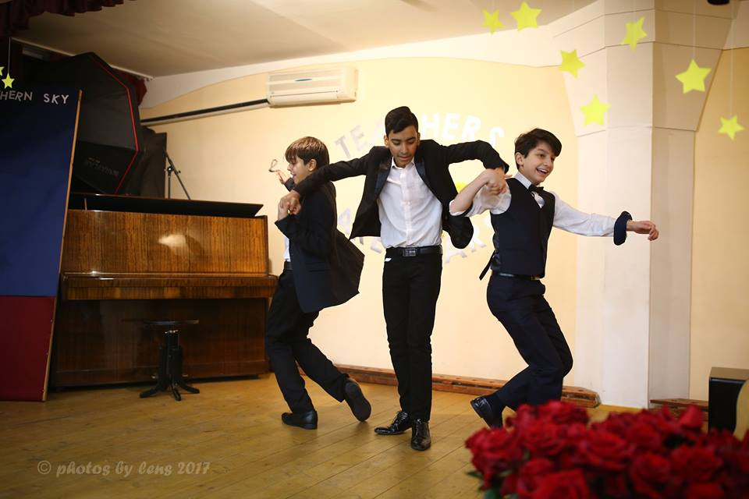
EVENTS

Slide 16
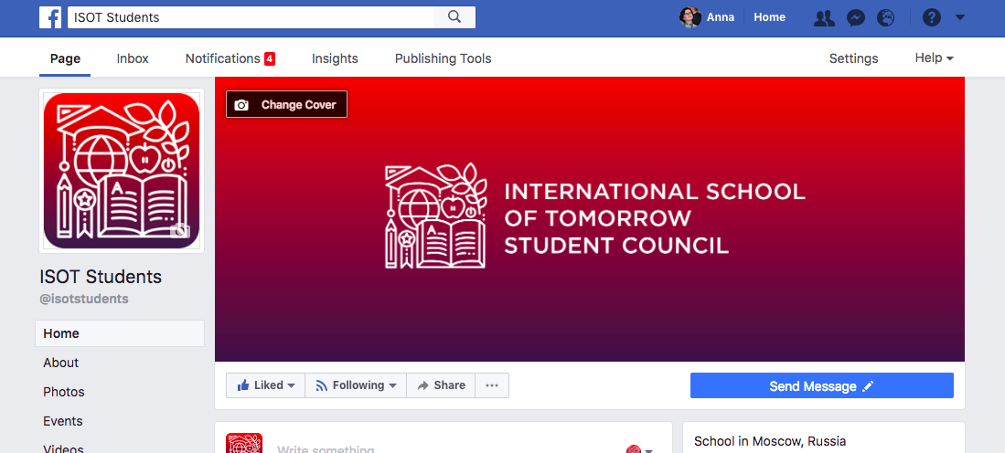
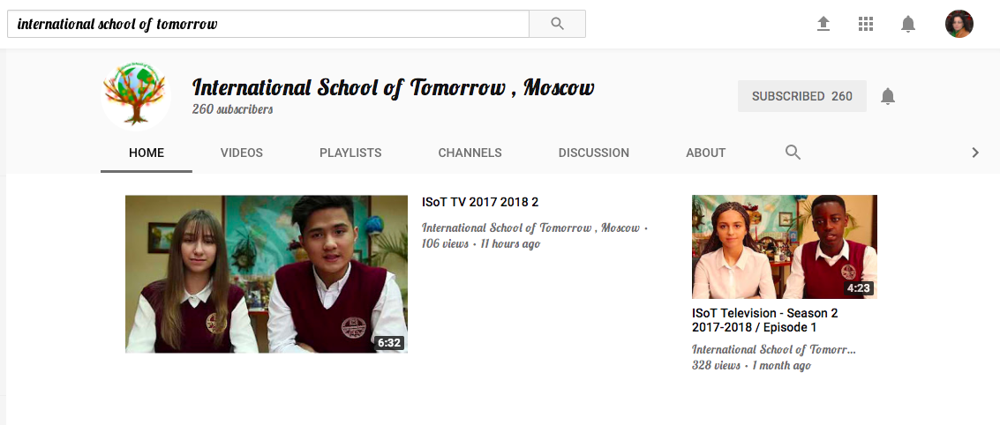
ISOT ON YOUTUBE and FACEBOOK

Slide 17
MITCHEL REZNICK
Professor of Learning Research at
MIT Media Lab
PASSION
PROJECT
PLAY
PEERS
4 P’S
OF CREATIVE LEARNING

Slide 18
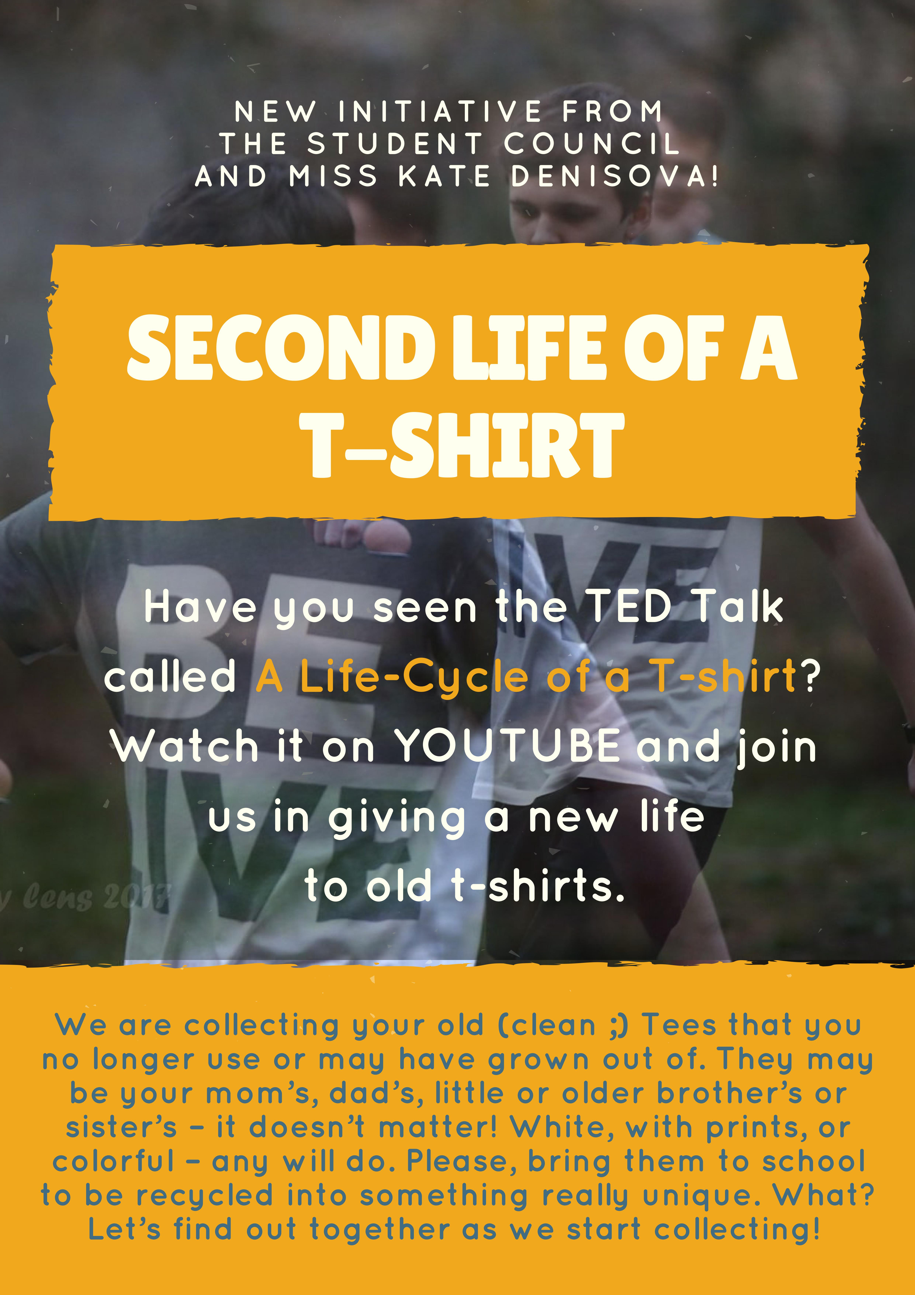
INITIATIVES
HELP YOUR CHILD DONATE AN OLD
T-SHIRT FOR AN ECO PROJECT
AND MAKE 50 MERITS

Slide 19
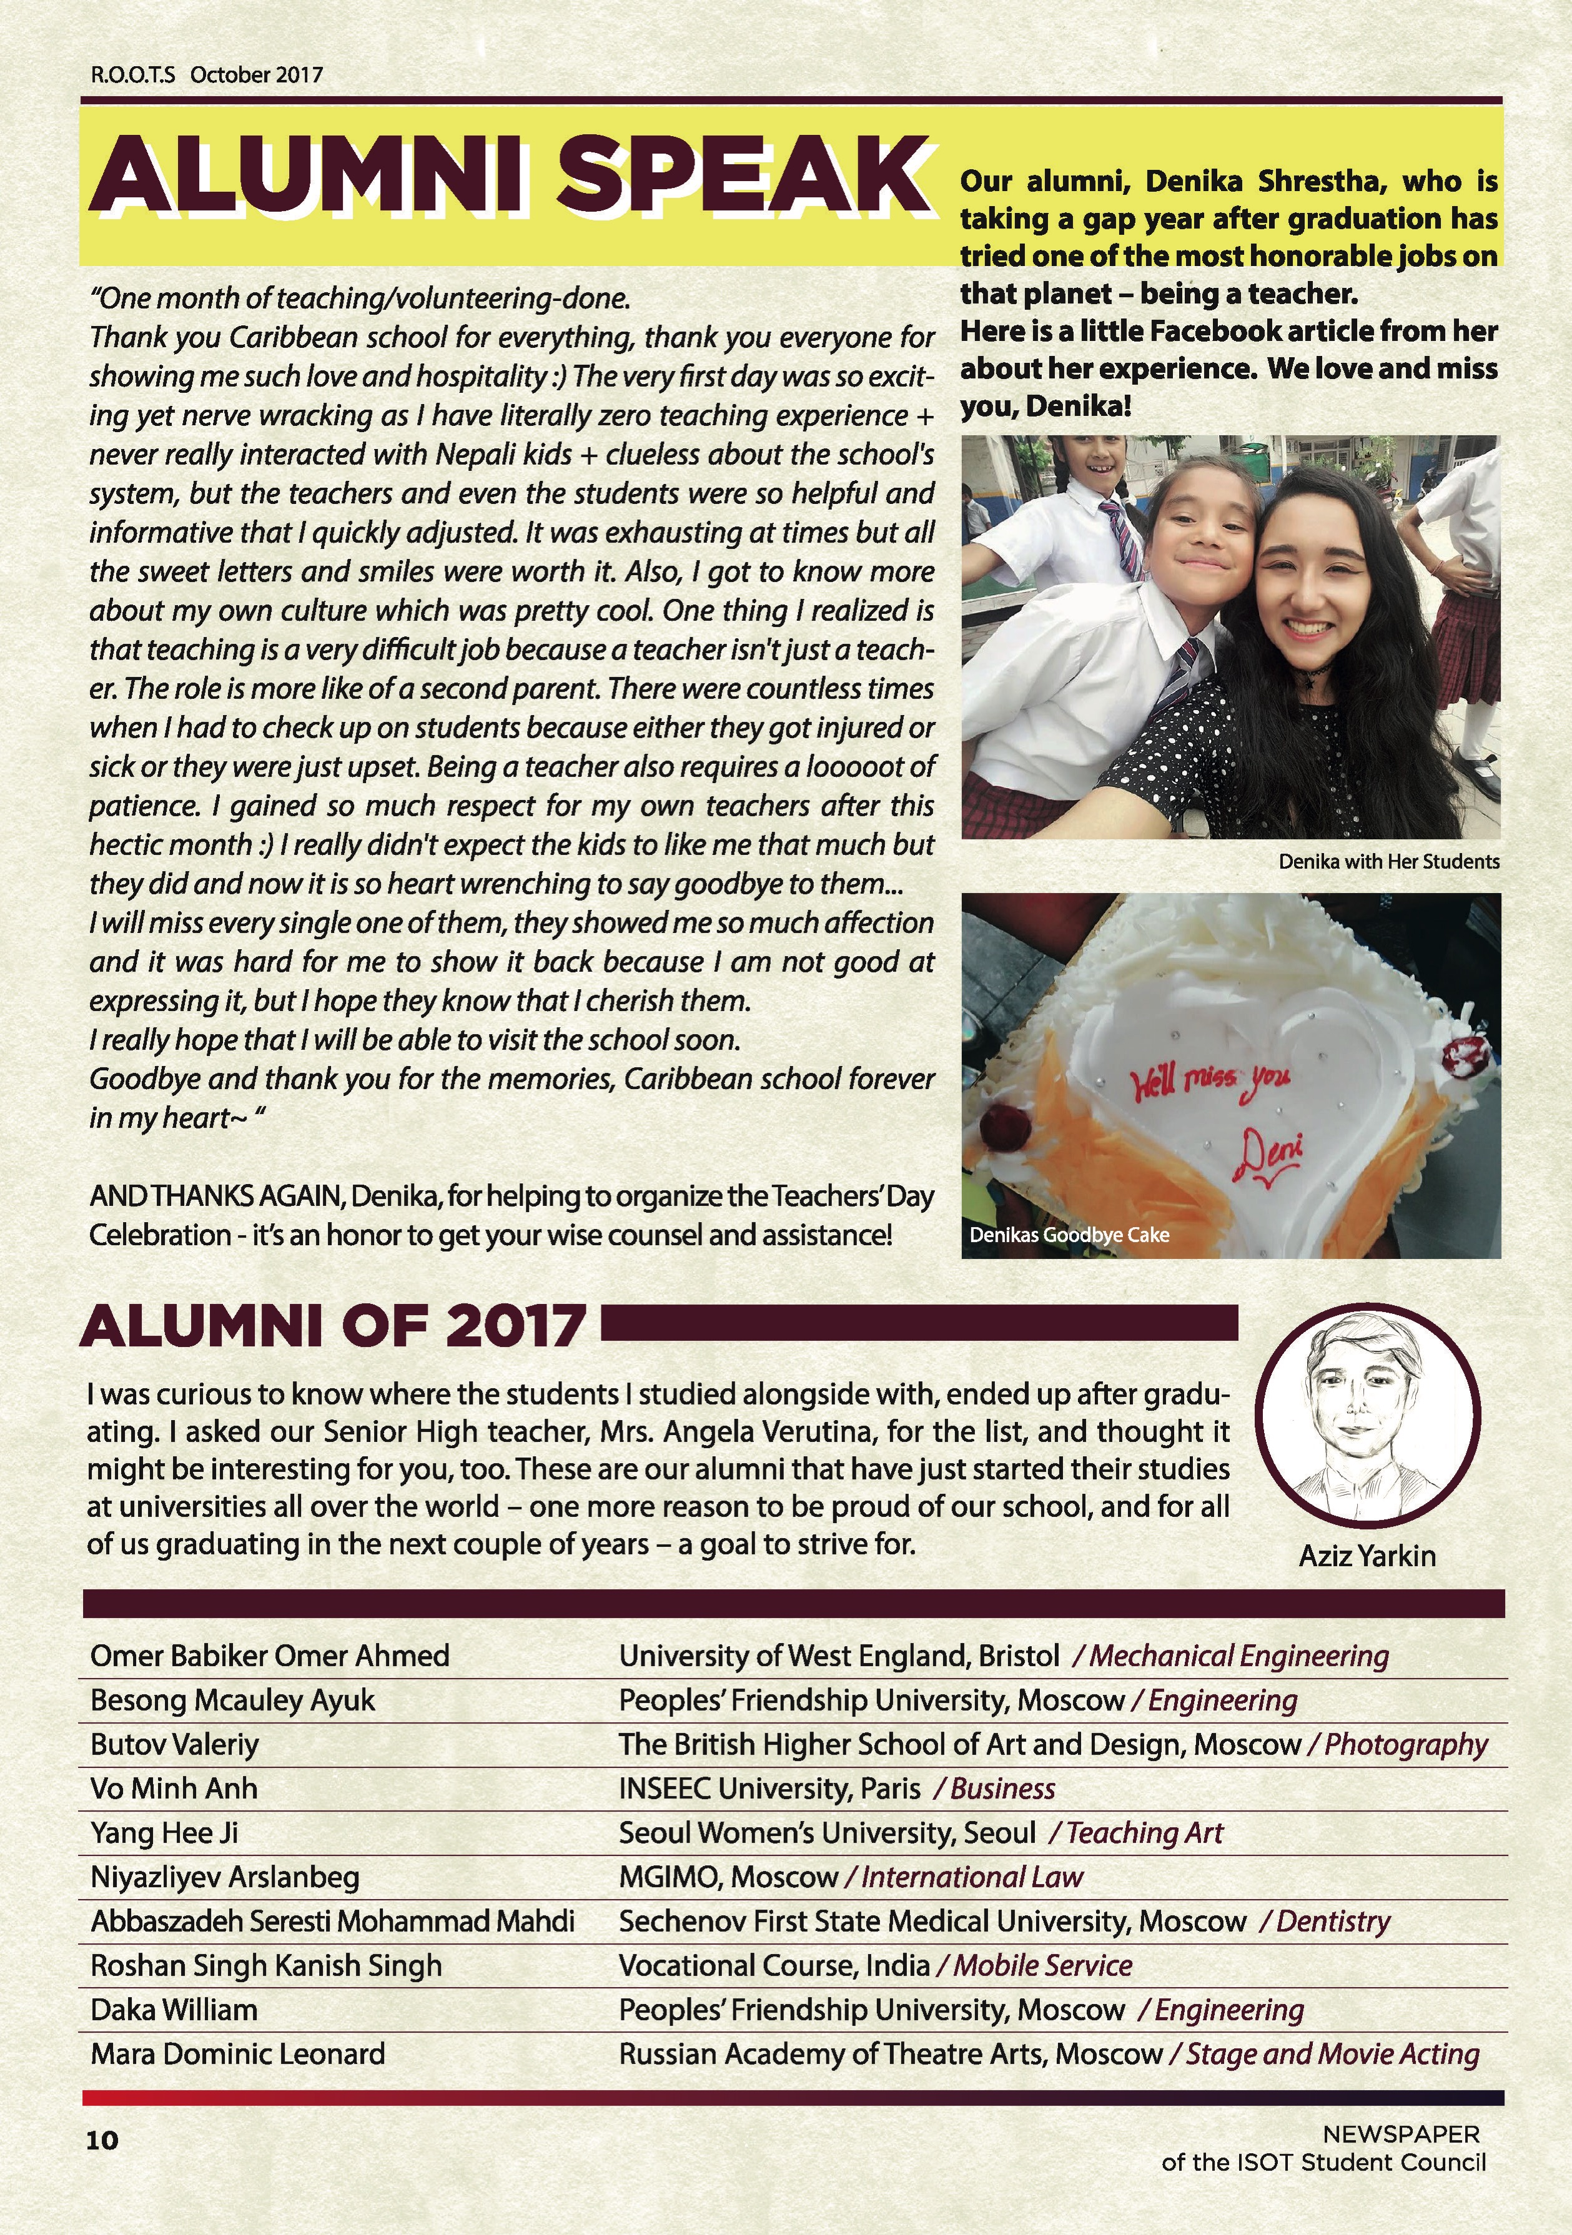
ISOT ALUMNI OF 2017

